Slide 1
NATIONAL POLICE
Results
Inter-institutional Program for Attention and Integral Development of Adolescence and Youth for the Promotion of a Culture of Peace
Evaluated Period: January 1 to July 23, 2020

Slide 2
12 Institutions of our Good Government (National Police, INIFOM, MIFAN, MINED, INATEC, MEFCCA, MINJUVE, MINSA, IND, INC, MINIM and PPDH) participate in the execution of the Program.
Components of the Program
Interinstitutional Social Care
Youth Culture, Culture of Peace
Entrepreneurship and Youth Development
Community Police Relationship

Slide 3
ACHIEVEMENTS
394,031 mothers and fathers trained in "Addiction Prevention" topics, recognizing the importance of being alert to signs that their daughters and sons are having addiction problems, acquiring the commitment to strengthen communication.
91,280 house to house visits with 316,880 adolescents and young people, motivating them to join sports and cultural activities.
27,360 Community Counseling Sessions to 186,522 people, promoting the promotion of values in a culture of equity and harmonious coexistence, prevention of violence, treatment and family support for people with addictions, alcoholism and drug addiction problems.
20,355 Specialized Care Sessions to 27,690 young people, through the officers of the Directorate of Youth Affairs and Heads of Sectors of the National Police, providing tools to resist addictions,.

Slide 4
ACHIEVEMENTS
9,732 Sports Activities with the participation of 486,119 people; Chess, Basketball, Track and Field and indoor soccer, Baseball and Kickball.
6,744 young people reintegrated into the educational system.
4,828 Meetings with 302,026 Community Participants, among young people with behavioral difficulties, high school students and parents in order to Promote Values, Community Unity and Coexistence, self-care, drug consumption prevention and self-esteem by publicizing the work that is being developed through the Youth Training and Development Center "YOUTH" of the National Police.
2,793 Conversations with the theme: "Promotion of Values" aimed at 45,347 people in order to promote healthy recreation without vices.
2,060 care and self-care campaigns in communities, 358 neighborhoods in 130 municipalities with 82,596 protagonists.

Slide 5
ACHIEVEMENTS
1,863 Training workshops for parents benefiting 114,756 protagonists with the aim of strengthening values, assertive communication and a culture of peace.
1,598 Municipal Workshops for 92,816 Participants on: Promotion of Values, Community and Family Coexistence and Unity, self-esteem, self-care and prevention of drug and alcohol consumption.
1,067 religious activities with 95,035 participants among youth, parents, and community leaders on strengthening Christian values and a culture of peace.
441 community and vocational fairs for the promotion and dissemination of the available technical training programs with the participation of 103,287 protagonists of INATEC and the Youth Training and Development Center "YOUTH" of the National Police.
156 young entrepreneurs were awarded C$3,425,000.00 cordobas, in order to execute their investment plans.

Slide 6
POLICE-COMMUNITY RELATIONSHIP
134,183 preventive police plans, police intelligence and investigations with the occupation of 1,278 illegal firearms, we thwarted 13,767 criminal operations, of which we disarticulated 9,642, we also disarticulated 699 recipients of stolen objects (caps), for the prevention of violence and most dangerous crimes.
Operations against drug outlets in neighborhoods of the country, seizing:
- 21 kilos and 79 grams of cocaine
- 18 kilos 73 grams of Crack
- 1,365,200.65 pounds of marijuana
- 66,110 marijuana plants
- 10,487 marijuana seeds
At the end of the period, we registered 4 Youth Groups (Gangs) made up of 53 young people to whom we continue to provide monitoring and control in the Department of Managua.
There are no reported homicides due to the confrontation of youth groups or gangs in the period from January 1 to July 23, 2020.
The departmental and municipal capitals did not report gang confrontations on public roads, achieving tranquility and security in the community.

Slide 7
Meeting

Slide 8
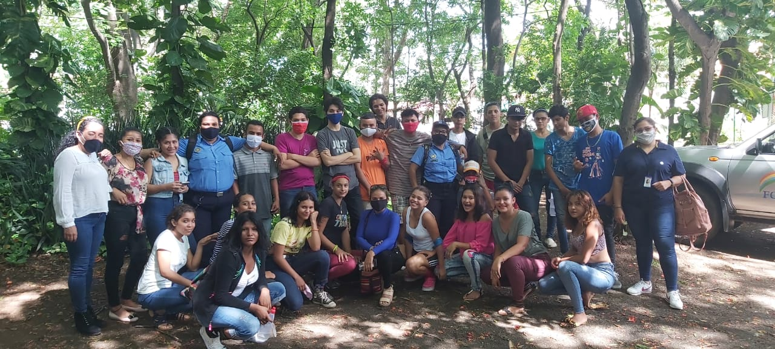
Police-Community Relationship

Slide 9
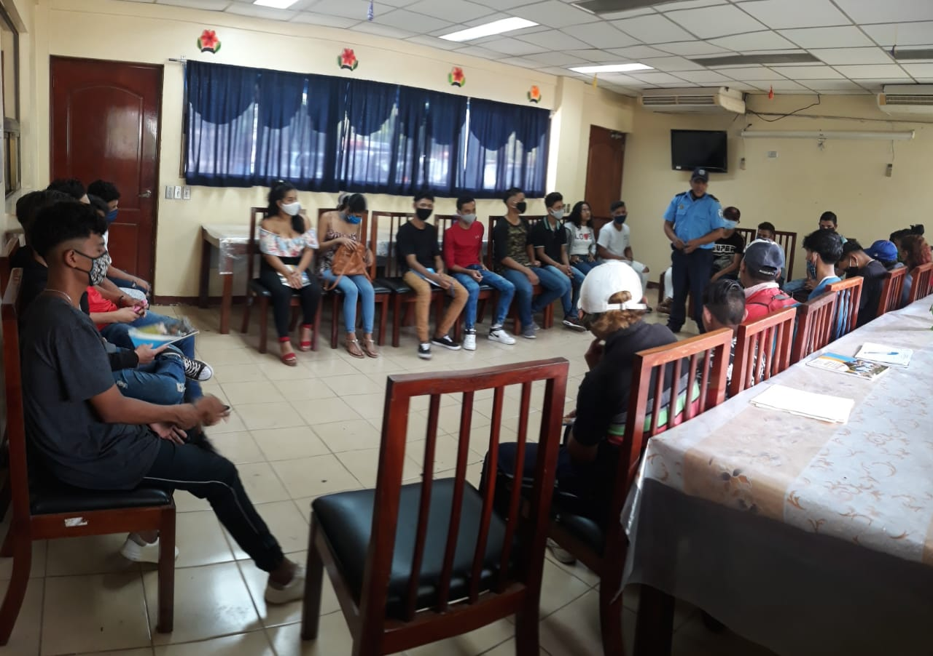
Training

Slide 10
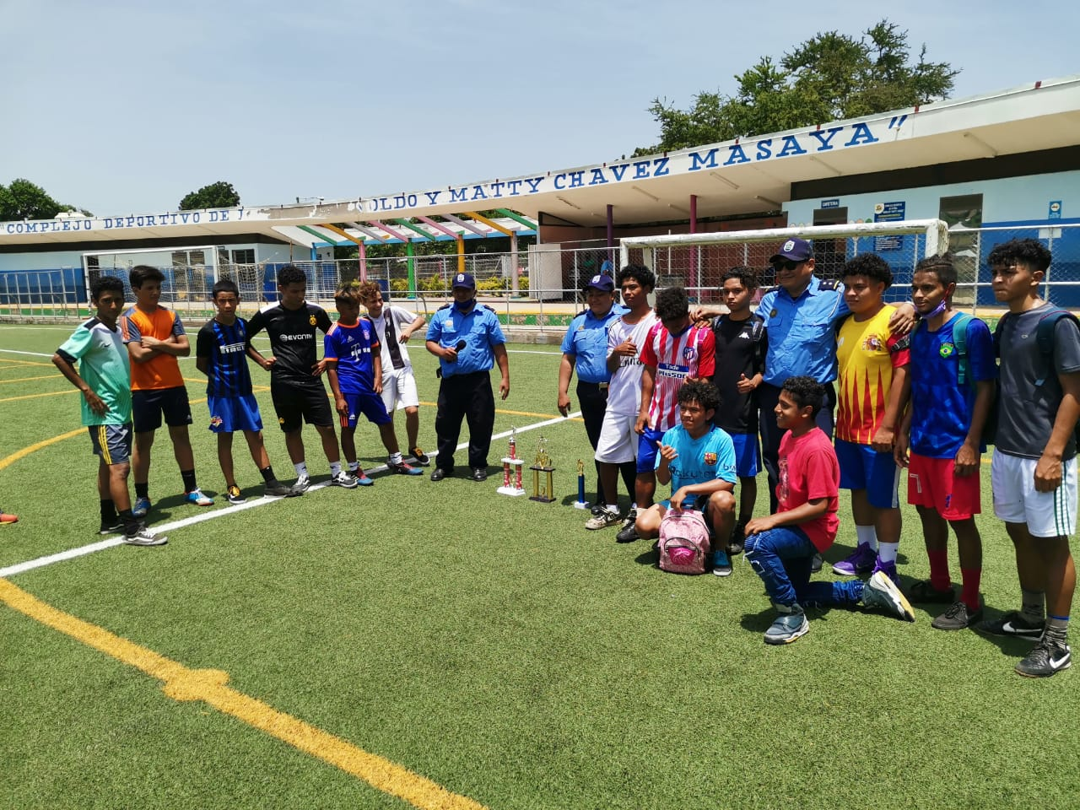
Sports Activity

Slide 11
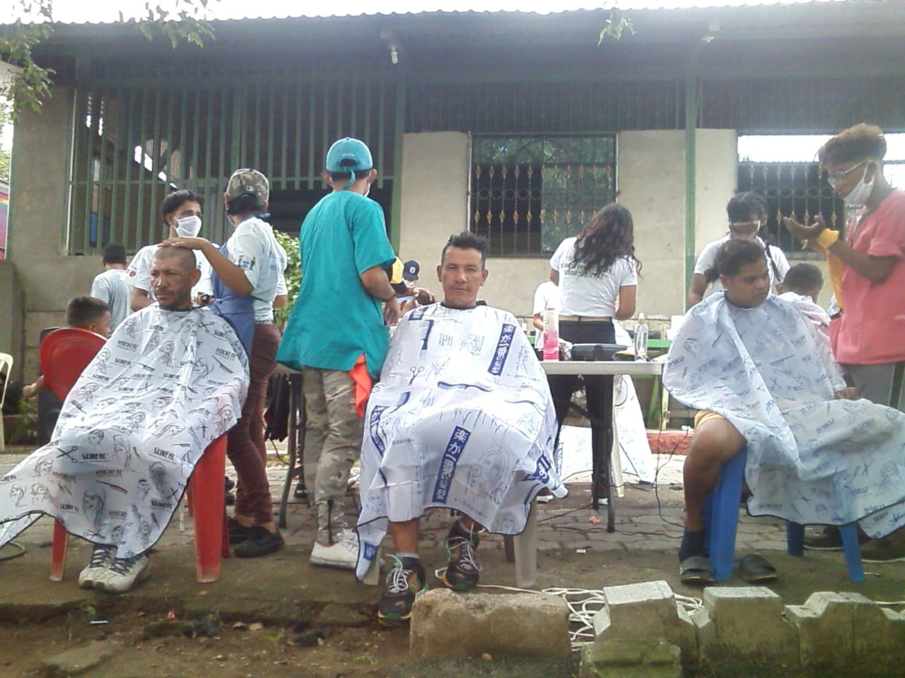
Entrepreneurship

Slide 12
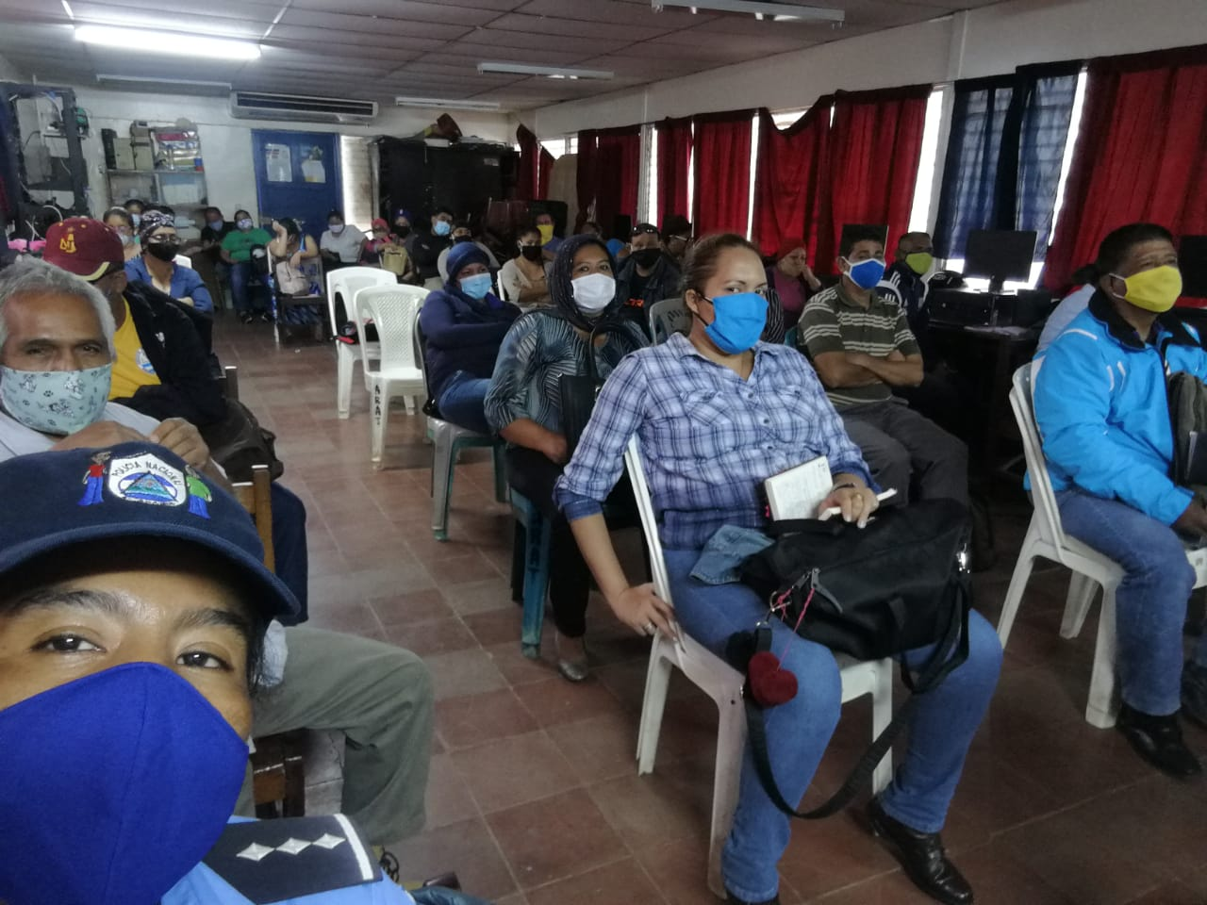
Seminar

Slide 13
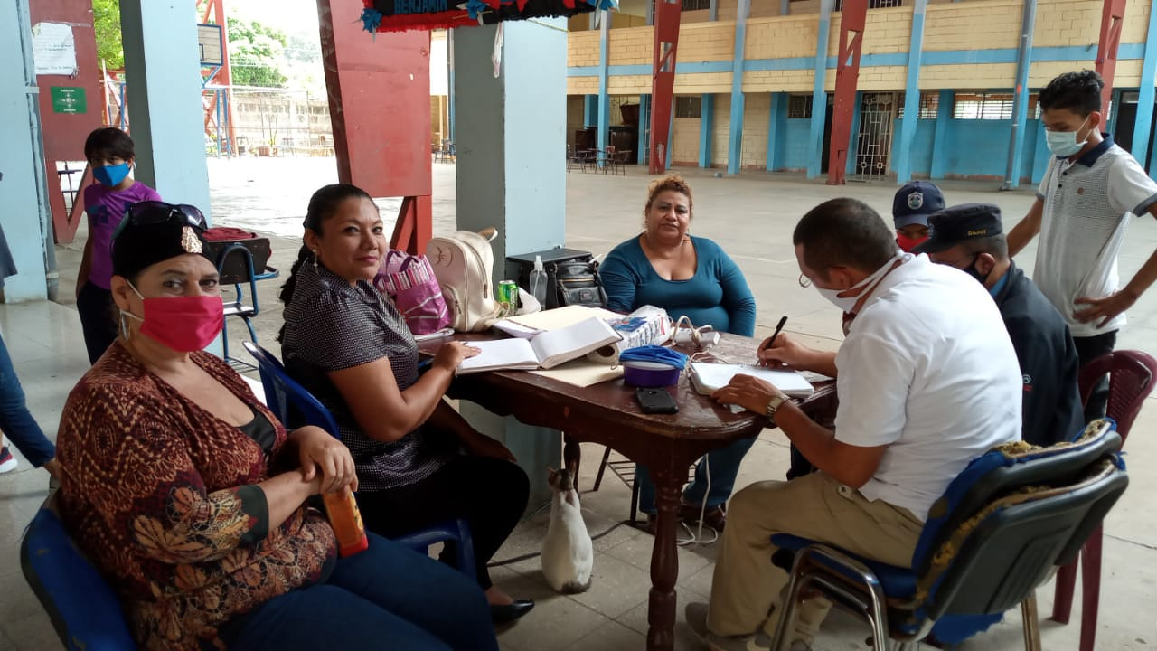
Work Meeting

