Slide 1
MINISTRY OF CITIZEN POWER FOR HEALTH
Health Situation of Nicaragua
January to July 2019-2020

Slide 2
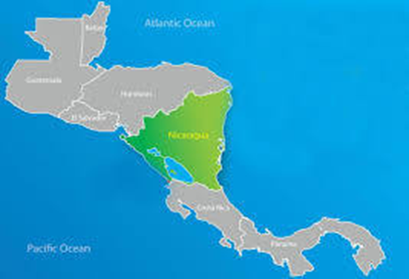
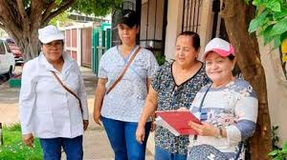
Nicaragua has an area of 130,370 km2, with a population of 6,465,513 inhabitants and a population density of 50 inhabitants per km2
Family and Community Healthcare Model
2,766 sectors (600 to 1000 families) organized, served by Family and Community Healthcare Teams, with 36,983 Healthcare Personnel and a Community Network made up of 42,572 members, ensuring the effective right to health of all Nicaraguans
Health Network
73 hospitals (12 National, 7 Regional, 12 Departmental and 42 primary hospitals).
143 Health Centers, 1,333 Health Posts and 2,841 Base Houses.
178 Maternity Homes, 93 Homes for People with Special Needs and 80 mobile clinics

Slide 3
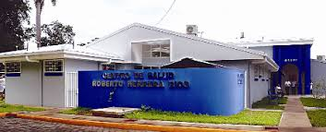
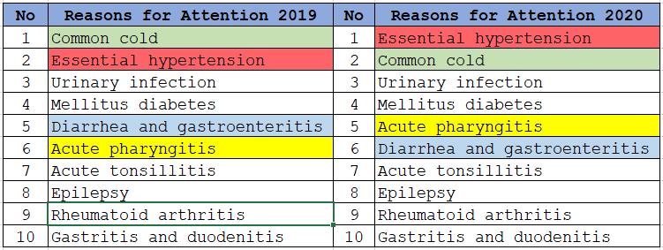
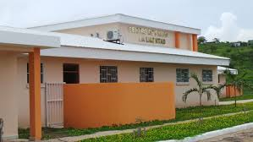
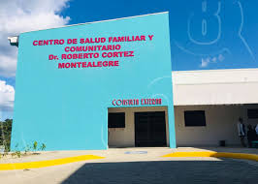
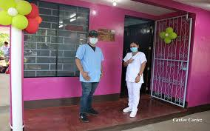
Top Ten Reasons for Care in
Health Units
January to July 2019- 2020

Slide 4
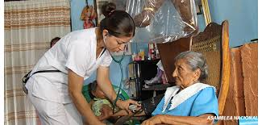
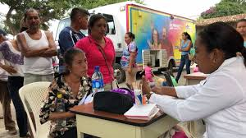
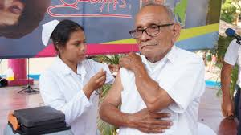
Chronic patients treated January-July
No | Pathology | 2019 | 2020
1 | Arterial hypertension | 117,833 | 127,843
2 | Diabetes | 60,880 | 66,525
3 | Rheumatic diseases | 51,755 | 54,165
4 | Epilepsy | 20,933 | 21,830
5 | Bronchial asthma | 17,220 | 18,587
6 | Kidney disease | 8,386 | 11,015
7 | Heart disease | 8,354 | 10,142
8 | Psychiatric illnesses | 5,803 | 6,638
9 | Alcoholism | 3,805 | 3,839
10 | Drug addiction | 636 | 603
11 | Parkinson | 434 | 455
12 | Autism | 129 | 139
13 | Alzheimers | 97 | 103

Slide 5
Top 10 causes of death by sex January until July 2020
No. | Causes of Death | Men | Women | Total
1 | Acute myocardial infarction | 1,923 | 1,526 | 3,449
2 | Diabetes mellitus | 1,428 | 1,283 | 2,711
3 | Influenza and pneumonia | 1,661 | 757 | 2,418
4 | Malignant tumors | 816 | 931 | 1,747
5 | Hypertensive diseases | 782 | 586 | 1,368
6 | Renal insufficiency | 875 | 326 | 1,201
7 | Cerebrovascular diseases | 424 | 452 | 876
8 | Liver diseases | 470 | 222 | 692
9 | Bronchitis, emphysema and asthma | 381 | 288 | 669
10 | Pericarditis, endocarditis, and acute myocarditis | 254 | 198 | 452
 | Other causes | 3,251 | 1,834 | 5,085
 | Total | 12,265 | 8,403 | 20,668
Note: 7 people have undetermined sex

Slide 6
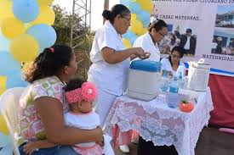
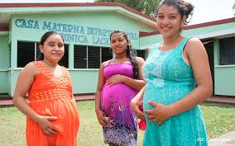
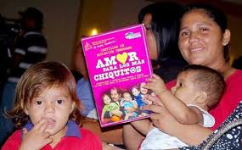
Services Provided
January to July 2019-2020
Type of attentions | January to July 2019 | January to July 2020
Total medical consultations | 13,175,183 | 12,611,348
First time prenatal care | 92,515 | 85,619
Subsequent prenatal care | 240,468 | 215,262
Total prenatal care | 332,983 | 300,881
Total controls for children under 1 year | 329,037 | 283,992
Total of controls to children from 1 to 4 years | 526,263 | 474,026
Source: Outpatient Service

Slide 7
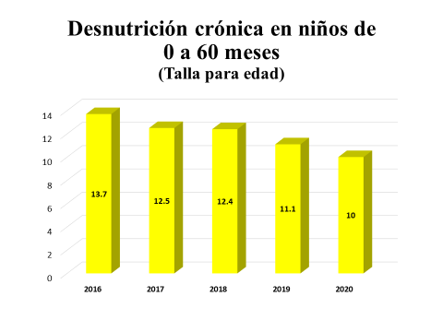
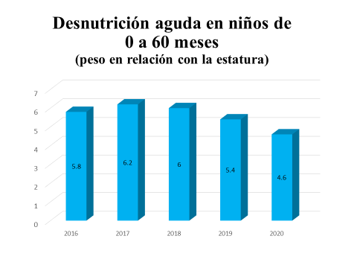
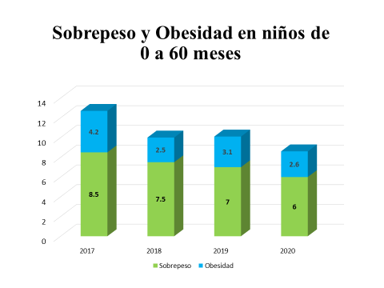
Acute malnutrition among children ages 90 to 60 months (size – age)
National Nutritional Census 2020
Acute malnutrition among children ages 90 to 60 months (weight – height)
Overweight and Obsetity in children ages 0 to 60 months

Slide 8
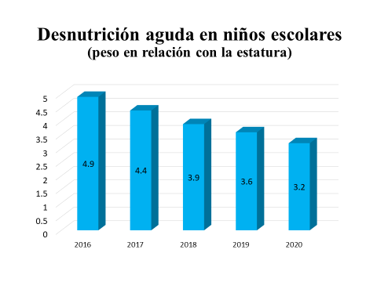
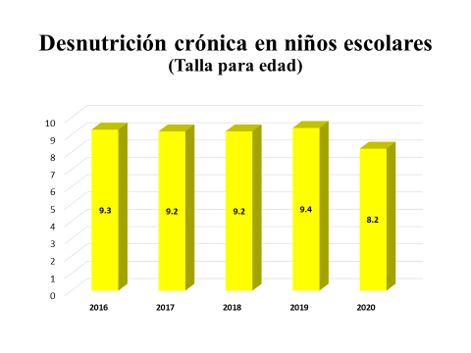
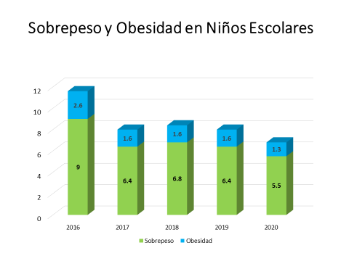
Acute malnutrition among school age children (weight – height)
Chronic malnutrition among school age children (size - age)
Overweight and Obesity among school age children

Slide 9
Epidemiological Situation

Slide 10
Events and diseases Subject to Epidemiological Surveillance
Nicaragua, as of Epidemiological Week 32 – 2020
PATHOLOGIES | ACCUMULATED UP TO 32 |  |  |  | OBSERVATION
 | Sick People |  | RATE
 | 2019 | 2020 | 2019 | 2020
Suspicious Dengue | 69506 | 32596 | 106.48 | 49.93 | A 53% reduction is observed compared to the previous year.
Confirmed Dengue | 3476 | 778 | 5.33 | 1.19 | A 78% reduction is observed compared to the previous year.
Suspicious Chikungunya | 101 | 9 | 0.2 | 0.02 | A 90% reduction is observed compared to the previous year.
Confirmed Chikungunya | 0 | 0 | 0 | 0 | -
Suspicious Zika | 86 | 10 | 0.17 | 0.02 | An 88% reduction is observed compared to the previous year.
Confirme Zika | 0 | 0 | 0 | 0 | -
Malaria | 6989 | 17961 | 10.7 | 27.5 | An increase of 1.5 times is observed compared to the previous year.

Slide 11
Events and diseases Subject to Epidemiological Surveillance
Nicaragua, Until Epidemiological Week 32 – 2020
PATHOLOGIES | ACCUMULATED UP TO 32 |  |  |  | OBSERVATION
 | Sick People |  | RATE
 | 2019 | 2020 | 2019 | 2020
E.D.A. | 183616 | 106114 | 357.08 | 205.23 | A 43% reduction compared to the previous year
I.R.A | 867014 | 673562 | 1686.11 | 1309.9 | A 22% reduction is observed compared to the previous year.
Pneumonia | 63472 | 50605 | 123.44 | 98.41 | A 20% reduction is observed compared to the previous year.
Confirmed Leptospirosis | 374 | 120 | 0.73 | 0.23 | A 68% reduction is observed compared to the previous year.

Slide 12
Incidence of COVID-19 patients per Epidemiological week
N= 3,413
Epidemiological Week

Slide 15
N= 128
Epidemiological Week

Slide 16
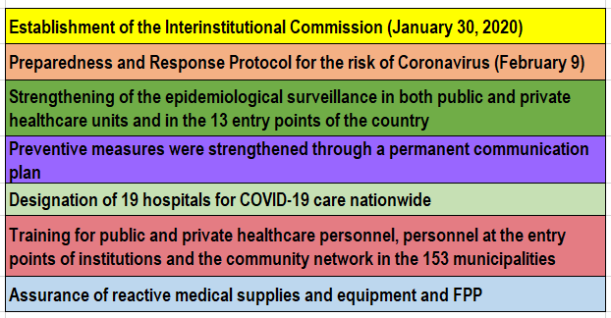
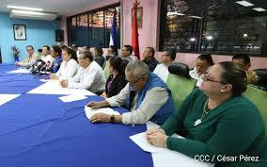
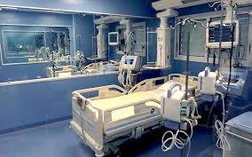
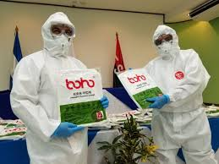
Key elements in preparing for and responding to the COVID-19 pandemic
Preparation since January 2020, two months before the appearance of the first COVID-19 patient.

Slide 17
Set of Actions Undertaken
Organization of primary and hospital care services
Conditioning of ICU rooms with ventilators, suction machines, vital signs monitors, among others; as well as PPE.
Family and Community Healthcare Team (ESAFC) and its network of community leaders (volunteers):
House-to-house visits reporting on preventive education (4,737,724 visits).
Early detection in order to initiate timely treatment and Save Lives.
Follow-up of people under self quarantine at home (nationals returning to the country) (42,000 travelers).
Responsible and Careful Follow-up of people with COVID-19 who are under treatment at home.
Sanitization Days with chlorine in public spaces with population concentration, such as markets, bus stops, schools, health units, public transportation, parks, among others.
Work with all sectors of the territory. THANK YOU

