Slide 1
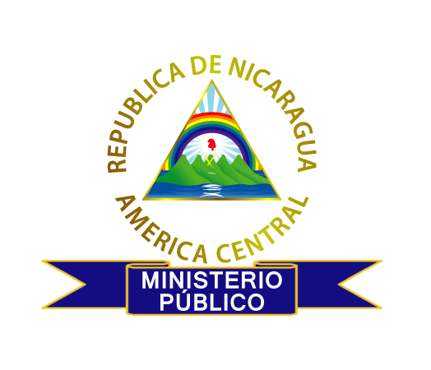
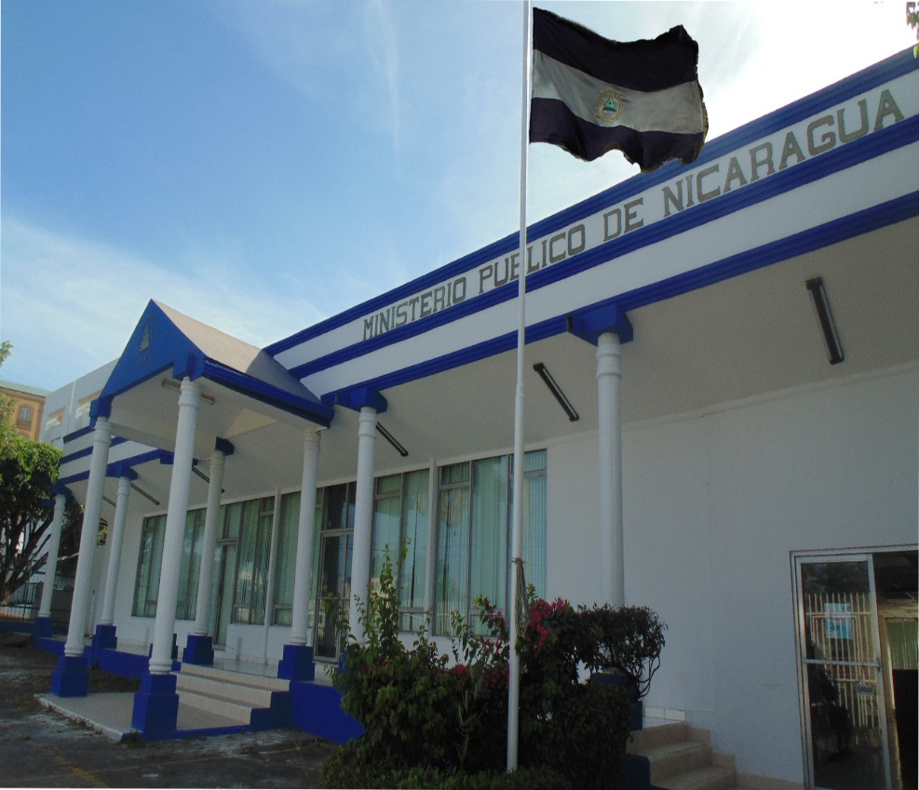
Public Prosecutor of Nicaragua
With the victims ... for Justice!

Slide 2
Public Prosecutor of Nicaragua
Functions and actions carried out by the Public Prosecutor of Nicaragua
With the victims ... for Justice!

Slide 3
Public Prosecutor of Nicaragua Legal framework
Political Constitution of Nicaragua: Article 138, numeral 9, literal b, second paragraph.
Law number 346, Organic Law of the Public Prosecutor.
Decree 133-2000, Administrative By Laws of the Organic Law of the Public Prosecutor.
Law number 586, Career Law for the profession of Public Prosecutors.
Disciplinary By Laws of the Public Prosecutor.
Law number 406, Criminal Procedure Code of the Republic of Nicaragua.
Law 641, Penal Code of the Republic of Nicaragua.
With the victims ... for Justice!

Slide 4
Public Prosecutor of Nicaragua
Created by Law No. 346, the Public Prosecutor is an independent Institution, with organic, functional and administrative autonomy.
The Public Prosecutor is subordinate to the Political Constitution and the Legal Framework of Nicaragua. It is in charge of the prosecutorial function and the representation of the interests of the society and victims of crimes within the criminal process, thus guaranteeing effective judicial protection.
It performs its functions under the principles of independence, autonomy, specialization, indivisibility, unity of action and hierarchy, legality, objectivity, obligation and responsibility.
With the victims ... for Justice!

Slide 5
Public Prosecutor of Nicaragua
With the Public Prosecutor, the role of the victims that had been ignored for years, is rescued and this is the institution that enforces their rights in the criminal process, recognizing the rights of the victims in the constitutional reforms of 2014, in article 138 , numeral 9, literal b, second paragraph of the Political Constitution.
The Criminal Procedure System of the Republic of Nicaragua has been recognized as one of the best systems in its implementation and due to its accusatory nature, which separates the investigative function (National Police), accusatory function (Public Prosecutor) and judicial function (Power of Attorney).
With the victims ... for Justice!

Slide 6
Public Prosecutor of Nicaragua
Functions of the Public Prosecutor of Nicaragua
With the victims ... for Justice!

Slide 7
Public Prosecutor of Nicaragua
The Public Prosecutor is in charge of exercising criminal action in crimes of public action.
It receives complaints that are subsequently sent to the National Police with the legal guidelines to carry out the respective acts of investigation.
It receives the investigations of the National Police and determines the exercise of criminal action.
It requires reports from the Institute of Legal Medicine and expert opinions from the Laboratory of Criminalistics and Forensic Sciences.
With the victims ... for Justice!

Slide 8
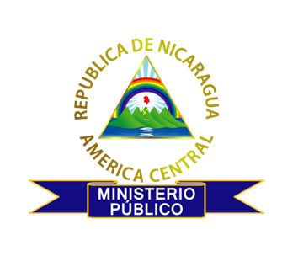
Public Prosecutor of Nicaragua
The Public Prosecutor represents the interests of society and the victim of the crime in the criminal process, which is specified in the representation made by prosecutors in the oral and public hearings of trials to which they appear, to support and demonstrate the evidence gathered.
It defends the rights of the victims, without prejudice, ensuring respect for the human rights of all the parties involved in the criminal process.

Slide 9
Public Prosecutor of Nicaragua
For the exercise of its functions, the Public Prosecutor has four Specialized Units, which have national jurisdiction:
1- Specialized Unit against Organized Crime
Composed of prosecutors who are specialized in organized crime, drug trafficking, money laundering, human trafficking, illegal immigration, crimes against the environment and intellectual property.
The specialization of these Prosecutors allows an adequate legal orientation of the investigation in order to achieve positive results in the fight against organized crime and related crimes.
With the victims ... for Justice!

Slide 10
Public Prosecutor of Nicaragua
2. Specialized Unit against Gender Violence
This unit is responsible for handling all cases related to Law 779, Comprehensive Law against Violence toward Women and reforms to Law 641, Penal Code, as well as the crime of non-compliance with alimony payments.
With prosecutors who are specialized in equality and gender-based violence, ensuring quality attention in order to achieve optimal results and guarantee access to justice.
With the victims ... for Justice!

Slide 11
Public Prosecutor of Nicaragua
3. Specialized Unit for Attention to Victims
Both in the investigative phase and in the judicial process, this Unit is in charge of providing a comprehensive service to children, adolescents and women who are victims of gender-based violence and sexual violence, in order to facilitate access to justice, avoid revictimization and guarantee reparations, taking into account their condition of vulnerability.
With the victims ... for Justice!

Slide 12
Public Prosecutor of Nicaragua
4. Specialized Unit in Criminal Justice for Adolescents.
This Unit, made up of Prosecutors Specialized in Criminal Justice for Adolescents, has as its main function to analyze the police reports received and carry out criminal action according to the specialized procedure in accordance with Law 287, Children and Adolescents Code of Nicaragua, taking into account the guiding principles of the Specialized Criminal Justice System for Adolescents, the greater interest of the adolescent, the recognition and respect for their human rights, protection and integral development, as well as their reintegration to their family and society.
With the victims ... for Justice!

Slide 13
The Public Prosecutor of Nicaragua Controls in the exercise of their functions
Jurisdictional control: being the courts of justice who assess the accusation and all the requirements of the Prosecutor.
Control of parties: the Public Prosecutor represents the victim in the criminal process and the other parties involved can make requests to the Public Prosecutor.
Control of society: taking into account that hearings and trials are oral and public.
Political control: the Public Prosecutor is obliged to present an annual management report to the National Assembly.
Internal control: referring to the internal regulations of fiscal management and the Disciplinary Regulations.
With the victims ... for Justice!

Slide 14
Public Prosecutor of Nicaragua
Actions of the Nicaraguan Public Prosecutor
With the victims ... for Justice!

Slide 15
Public Prosecutor of Nicaragua
To carry out its work, the Public Prosecutor has strategic lines that are in accordance with the National Human Development Plan and the State Policies on Criminal Matters, which have, as strategic objective, the development of a series of actions to improve the quality of the work of the Public Prosecutor, through periodic specialized trainings.
With the victims ... for Justice!

Slide 16
Public Prosecutor of Nicaragua
From the Public Prosecutor, we can highlight that during 2019 we received a total of 31,053 investigations and complaints, of which 23,231 were investigations from the National Police and 7,822 complaints received directly from the victims, which were sent to the National Police for due process.
We presented 25,063 accusations against 28,905 individuals and 2,633 previous mediations, we also issued 1,558 misdemeanors and 1,232 dismissals. The remaining 567 admissions were related to extensions of investigation, either provisional or definitive dismissal in the Adolescent Criminal Justice Court and ongoing investigations.
In 2019, the Public Prosecutor in its entirety provided 107,437 services to users, among which we highlight 53,358 services to victims of different crimes.
With the victims ... for Justice!

Slide 17
Public Prosecutor of Nicaragua
Within the actions of the Public Prosecutor, this entity convenes the Opposition Competition for the entry of Prosecutors according to Law 586, Law of the Public Prosecutor Career. The career of the Public Prosecutor is governed by the following principles: Equality, merit, capacity, stability, efficiency, specialty and responsibility.
The officials of the Public Prosecutor, within the framework of their actions, must proceed in a professional manner, respectful of the legal system, with ethical and moral principles, preserving integrity, transparency and the obligation of probity in order to maintain quality in the service.
According to the Public Prosecutor Career Law, officials from both the substantive and administrative areas must be in a position to be transferred to work in the place where they are designated by the Attorney General of the Republic, according to the needs of the Institution.
With the victims ... for Justice!

Slide 18
Public Prosecutor of Nicaragua
Continuing with the actions carried out by the Public Prosecutor, the national strategy called "Containment Wall", which in the first instance is carried out in coordination with the Nicaraguan Army and the National Police. The strategy was guided by the Government Reconciliation and National Unity in order to combat organized crime, money laundering, human trafficking, smuggling and other related crimes. Its main objective is to seize or divert as much of the drugs trafficked as possible, as they access the national territory, preventing those that transit through Central American territory from entering Nicaraguan territory and thereby avoiding the deterioration of our society.
With the victims ... for Justice!

Slide 19
Public Prosecutor of Nicaragua
The Public Prosecutor is a part of different inter-institutional commissions that allow a comprehensive attention and approach to specialized cases, among which we can highlight the following:
National Council against Organized Crime: Its main function is to develop national policies and programs in the prevention and fight against drug trafficking, money laundering and organized crime.
National Coalition against Trafficking in Persons: its main objective is the discussion and elaboration of operational plans and national strategies for the fight against trafficking in persons.
National Anti-Money Laundering Commission: whose function is to identify and evaluate the national risks related to money laundering and terrorist financing. The Public Prosecutor is also part of the Sub-Commission for the Persecution of Money Laundering and Financing of Terrorism.
With the victims ... for Justice!

Slide 20
Public Prosecutor of Nicaragua
Among its actions, the Public Prosecutor provides support in the processing of International Criminal Assistance, which is entered through the Attorney General's Office.
It is part of the Central American and Caribbean Council of Public Prosecutors. It is also a part of the Ibero-American Association of Public Prosceutors, made up of 22 Public Prosecutors of Latin America.
In both instances, training, cooperation and the exchange of experiences and information are promoted between the Public Prosecutors for the prosecution of transnational crimes.
With the victims ... for Justice!

Slide 21
Public Prosecutor of Nicaragua
The Public Prosecutor, as part of the Criminal Justice System, in its action within the framework of its mandate, contributes to citizen security, access to Justice, social stability, tranquility, peaceful coexistence, social peace and the integral development of society. All of this allows Nicaragua to remain the safest country in Central America and one of the safest in Latin America.
Thank you very much.
With the victims ... for Justice!

